Slide 1
ebaja
Octavio Duran – Budget Liason
Brendon Jameson - CAD / Manufacturing Engineer
Benjamin Plis - Test Engineer
Abriana Romero - Project Manager
Jared Walker - Logistics

Slide 2

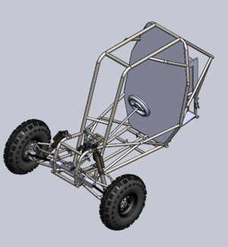
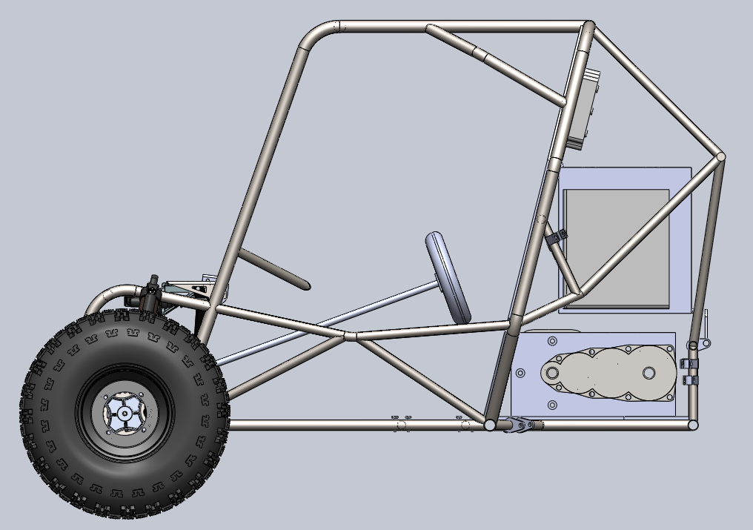
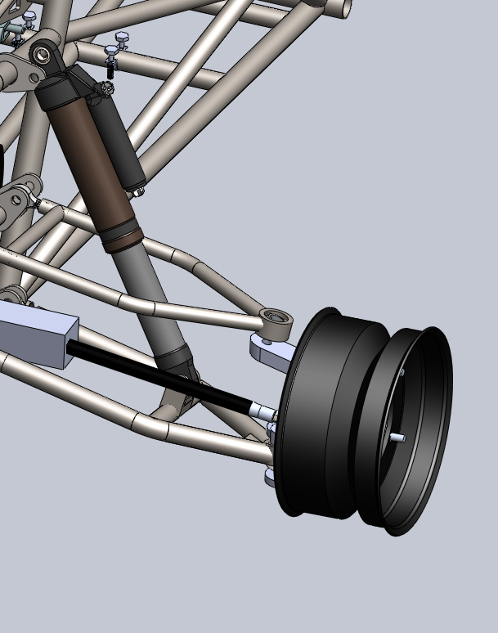
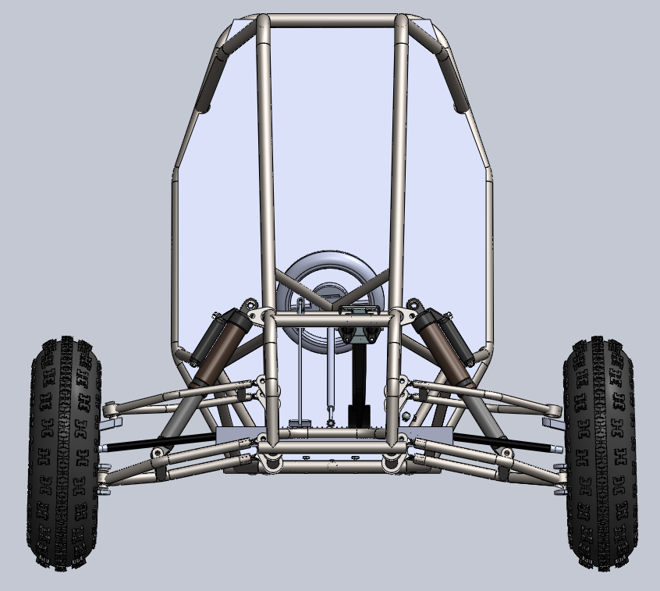
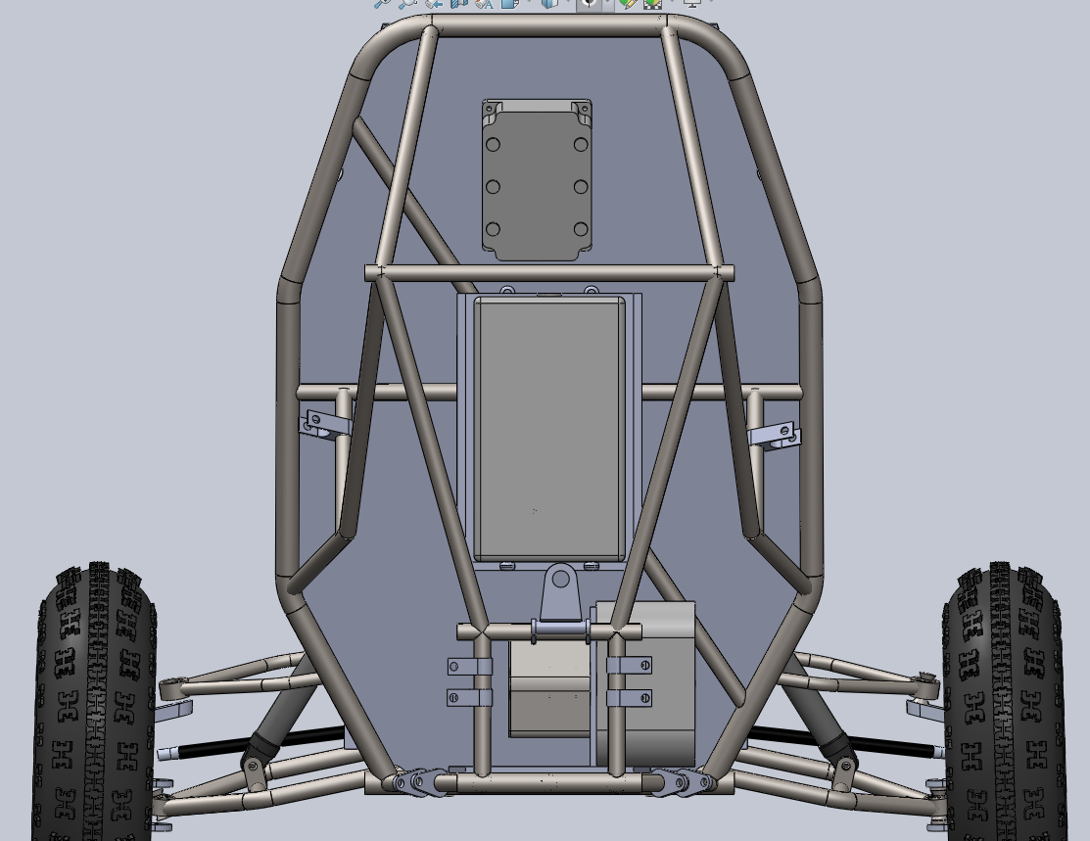
Design Efforts
Jared Walker​
21F13 02/08/22​

Slide 3
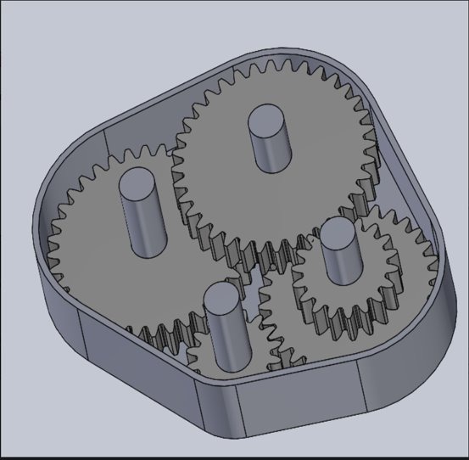
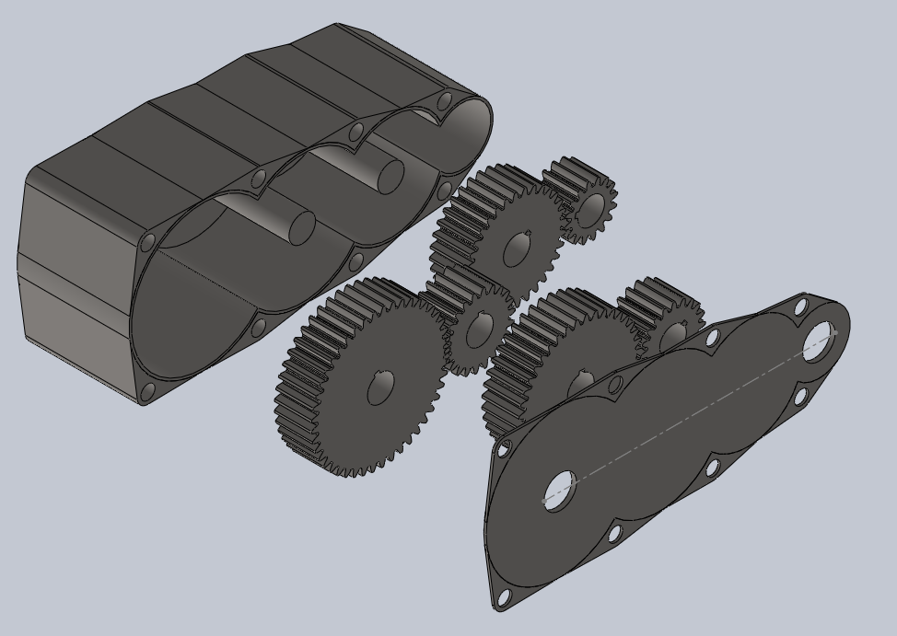
Design ITERATION (gEARBOX)
Octavio Duran
21F13 02/08/22

Slide 4
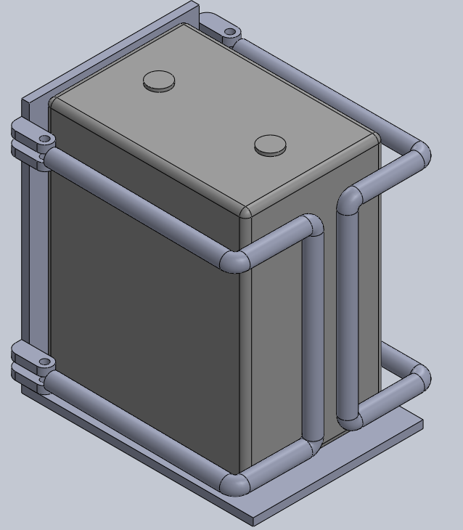
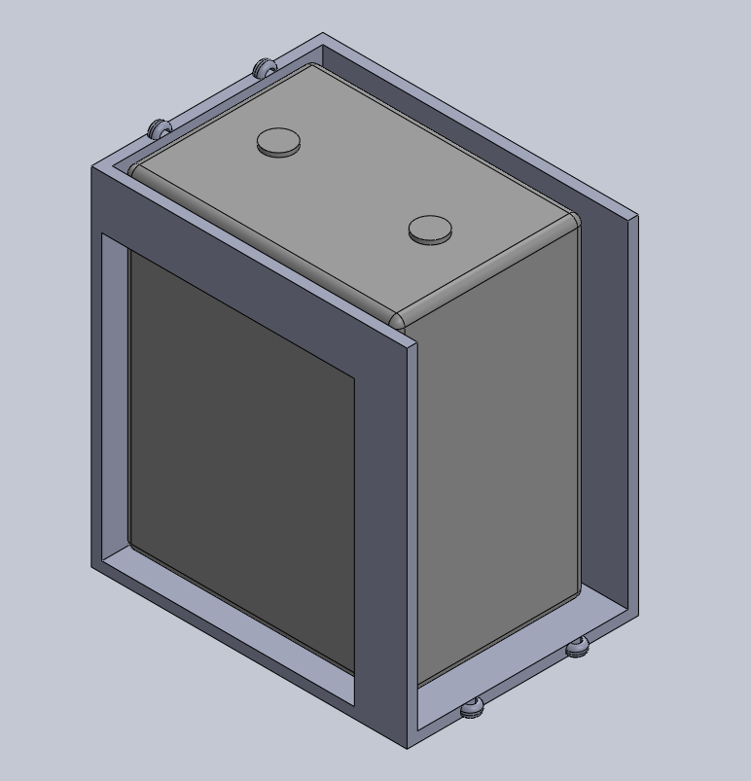
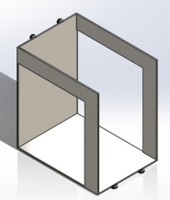
Design ITERATION (bATTERY CASING)
Brendon Jameson ​​
21F13 02/08/22

Slide 5
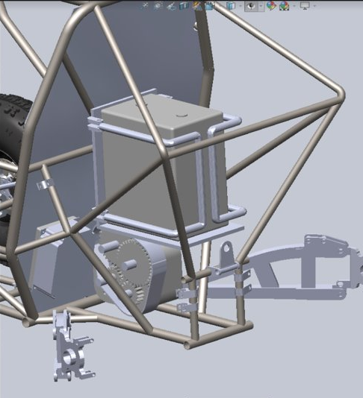
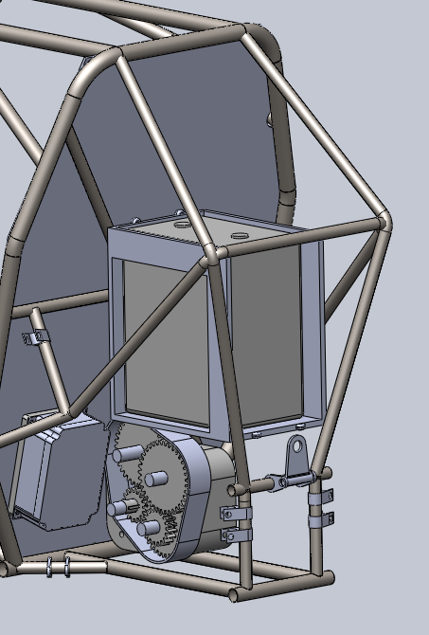
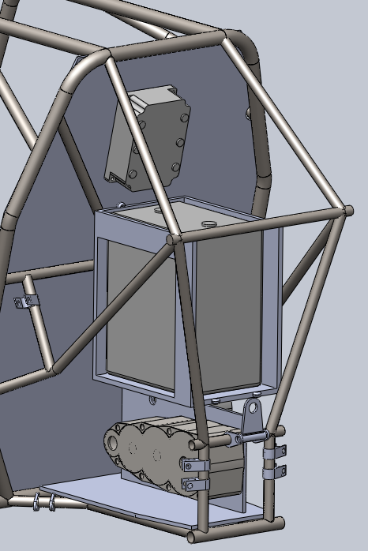
Design Efforts (FRAME)
Brendon Jameson ​
21F13 02/08/22

Slide 6
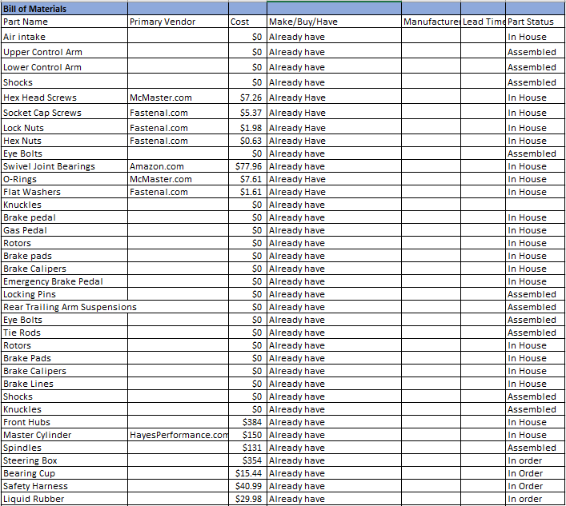
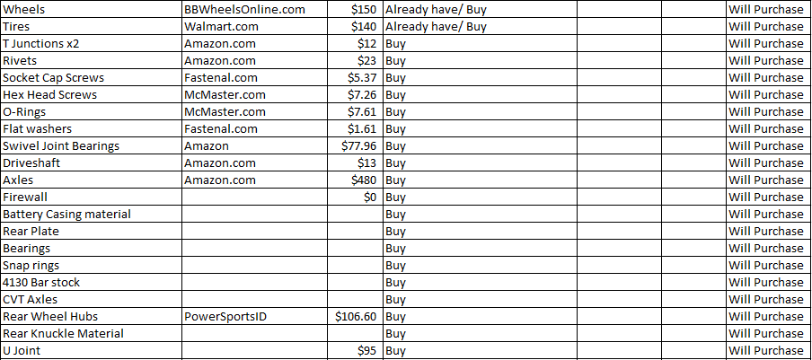
Purchasing Plan
Budget: $3,000
Remaining of Budget: $1,606
Octavio Duran ​
21F13 02/08/22

Slide 7
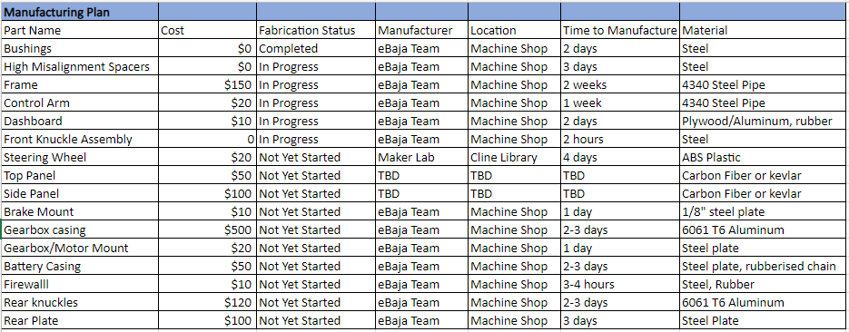
Manufacturing Plan
Abriana Romero ​​
21F13 02/08/22

Slide 8

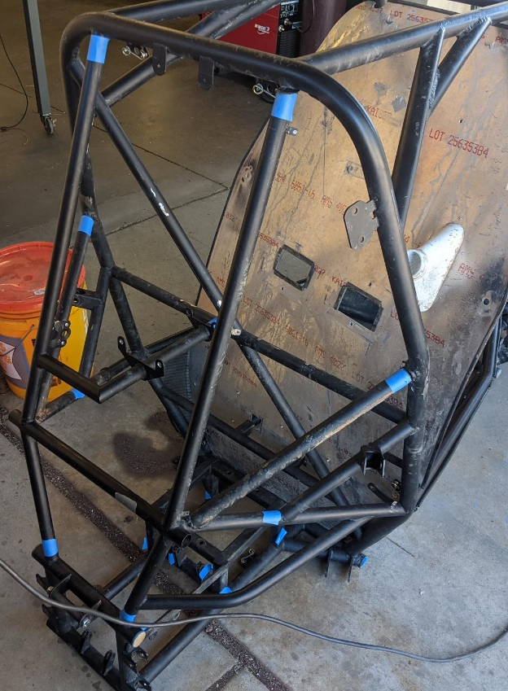
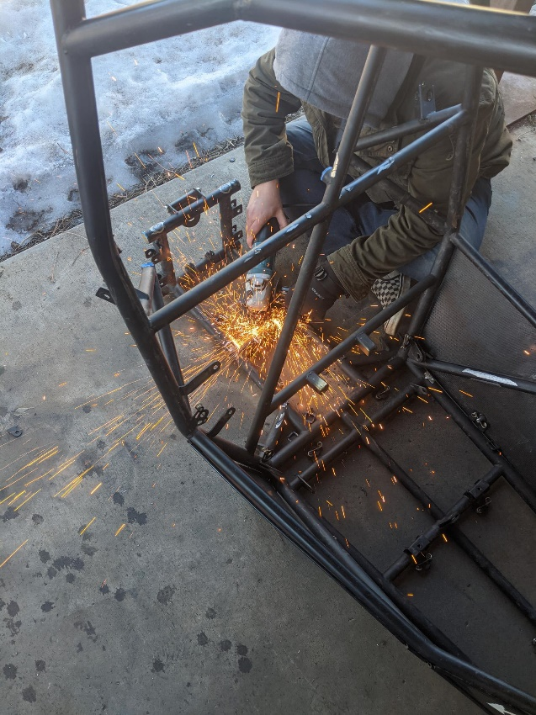
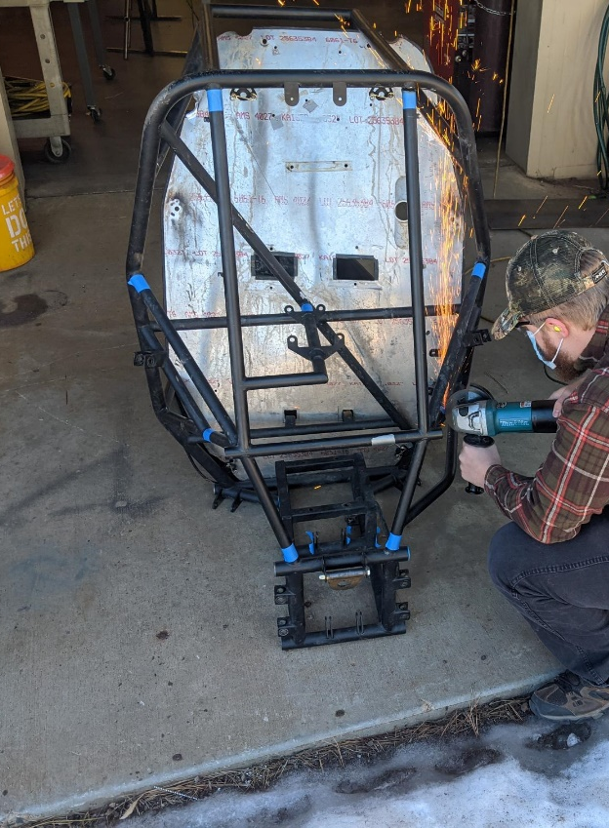
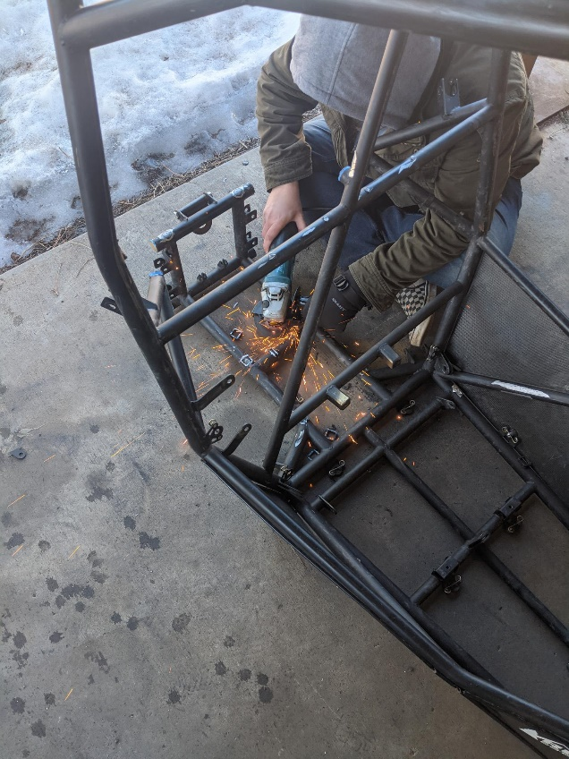
Demonstration
Abriana Romero ​​​
21F13 02/08/22

Slide 9
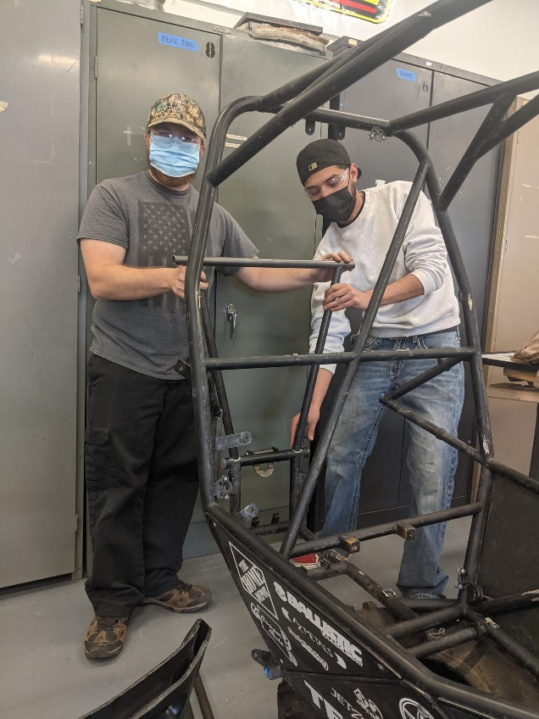
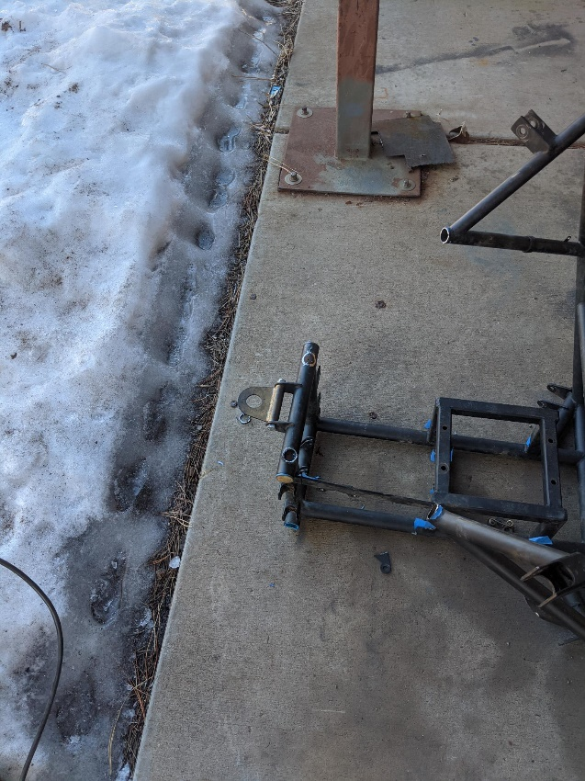
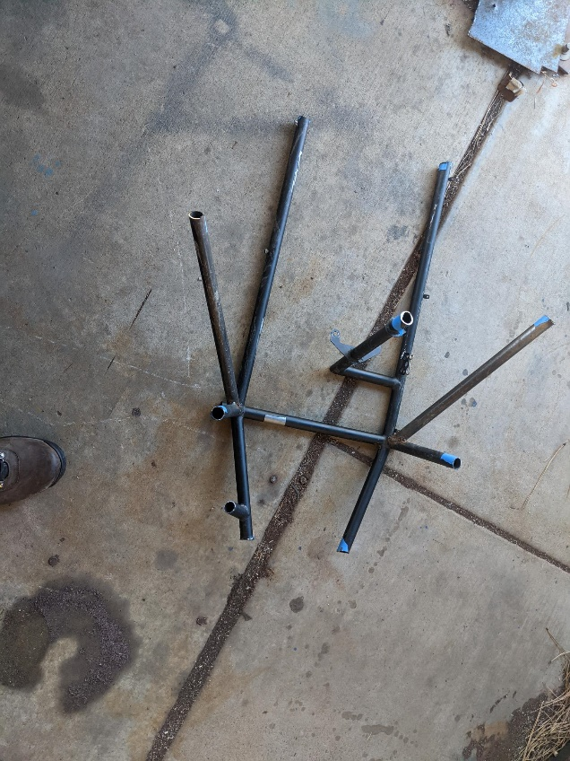
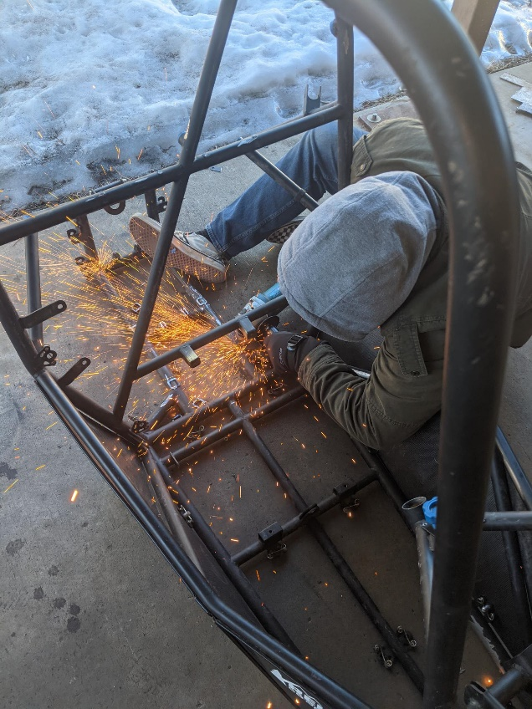
demonstration
Benjamin Plis​​​
21F13 02/08/22

Slide 10
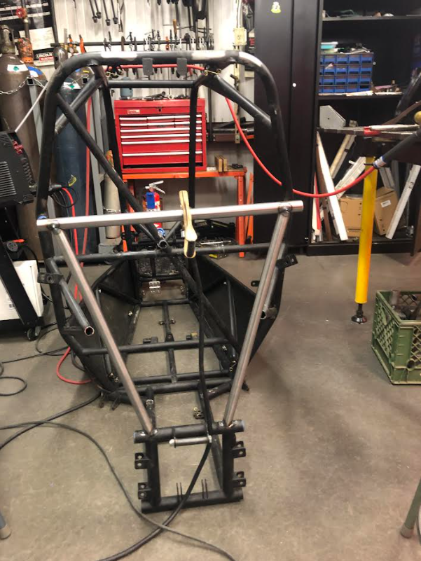
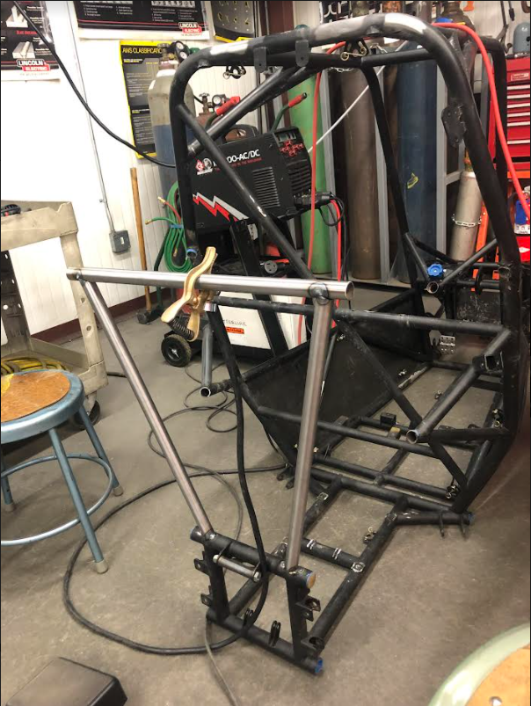
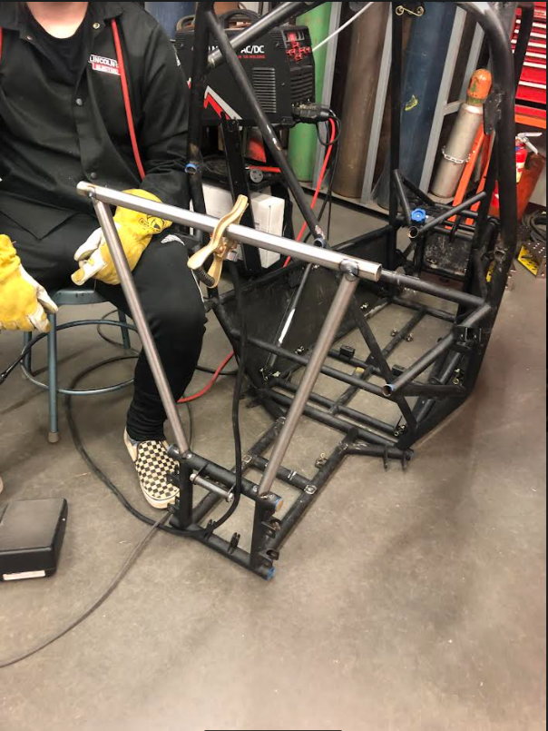
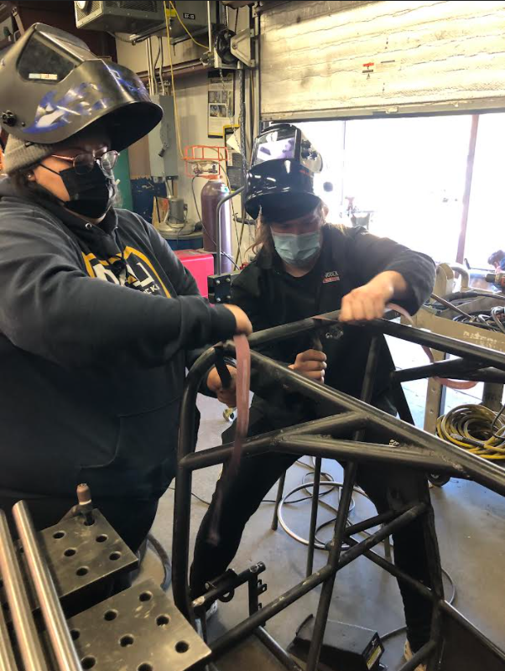
Demonstration
Benjamin Plis​​​​
21F13 02/08/22​

Slide 11
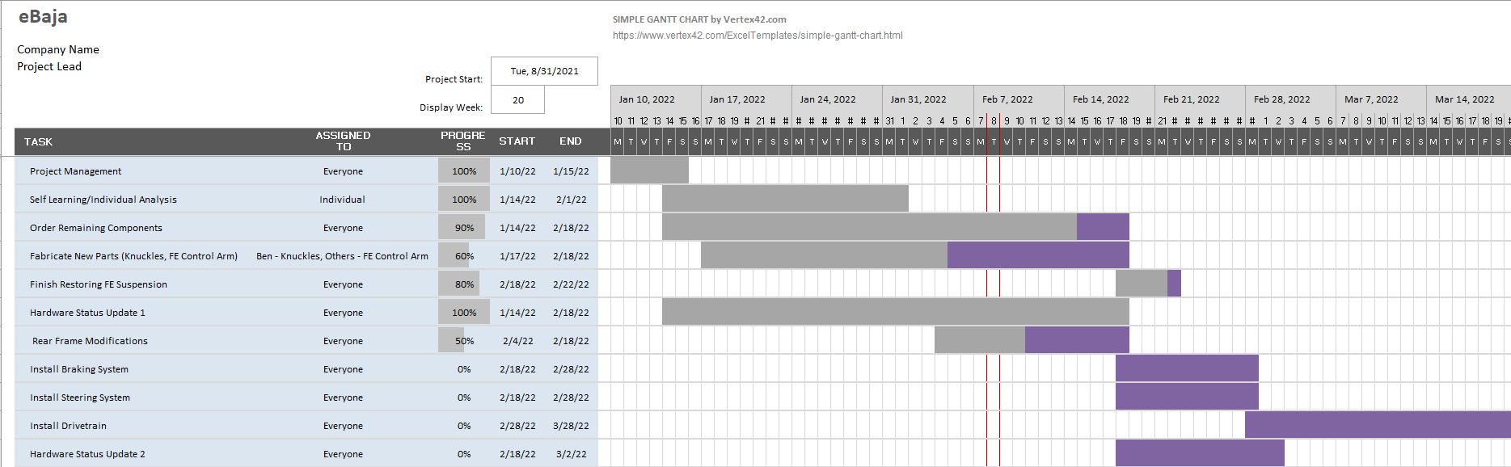
Gantt Chart
Jared Walker
21F13 02/08/22

Slide 12
Questions?

